Slide 1
TalktoAnonymous
Chat online, anonymously

Slide 2
TalktoAnonymous
When you like to chat online, but want to stay anonymous

Slide 3
Project Description
Have you ever had a great day but didn’t have anyone to share it with?
How about a bizarre event that you would like to discuss with someone who won’t think you are crazy?
Or even just venting about something that annoys you.
With the Talk To Anonymous App you can do all of those things.
Notes:
May require more than one slide

Slide 4
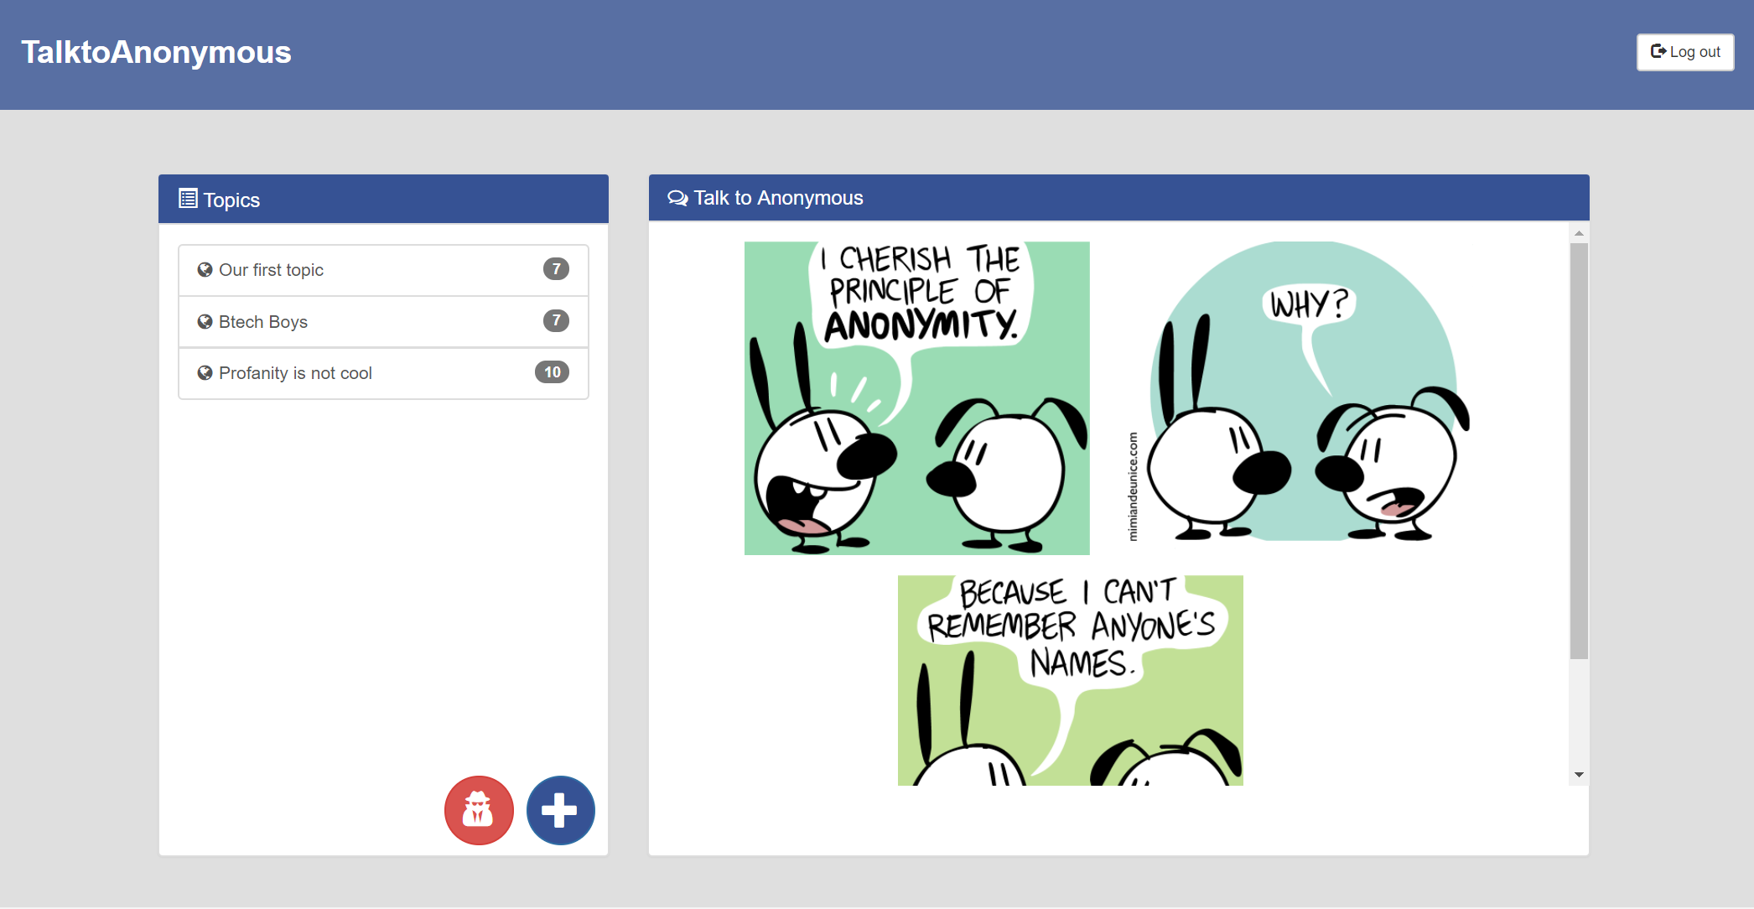
Motivation
Chat with others anonymously about personal topics
No personal information gets stored
Real-time
With Talk to Anonymous you can talk to other people, anonymously in real time.

Slide 5
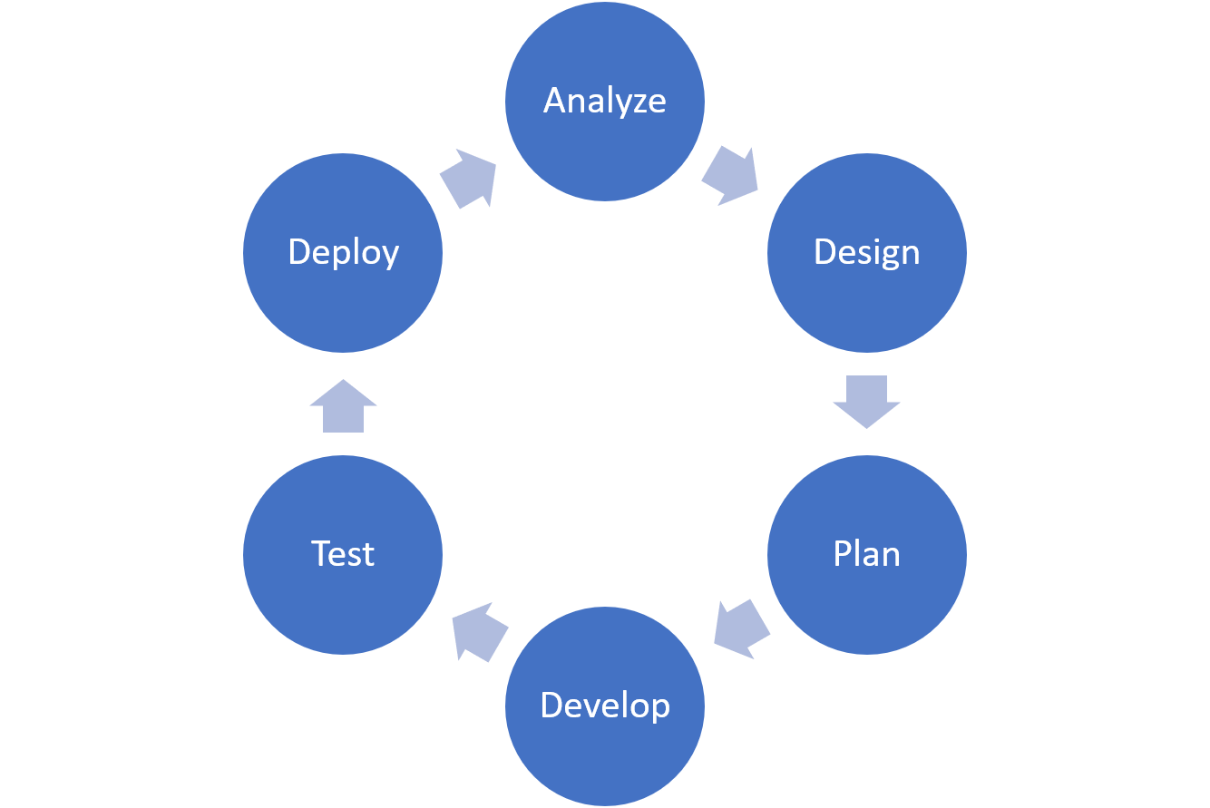
Design Process
Notes:
May require more than one slide

Slide 6
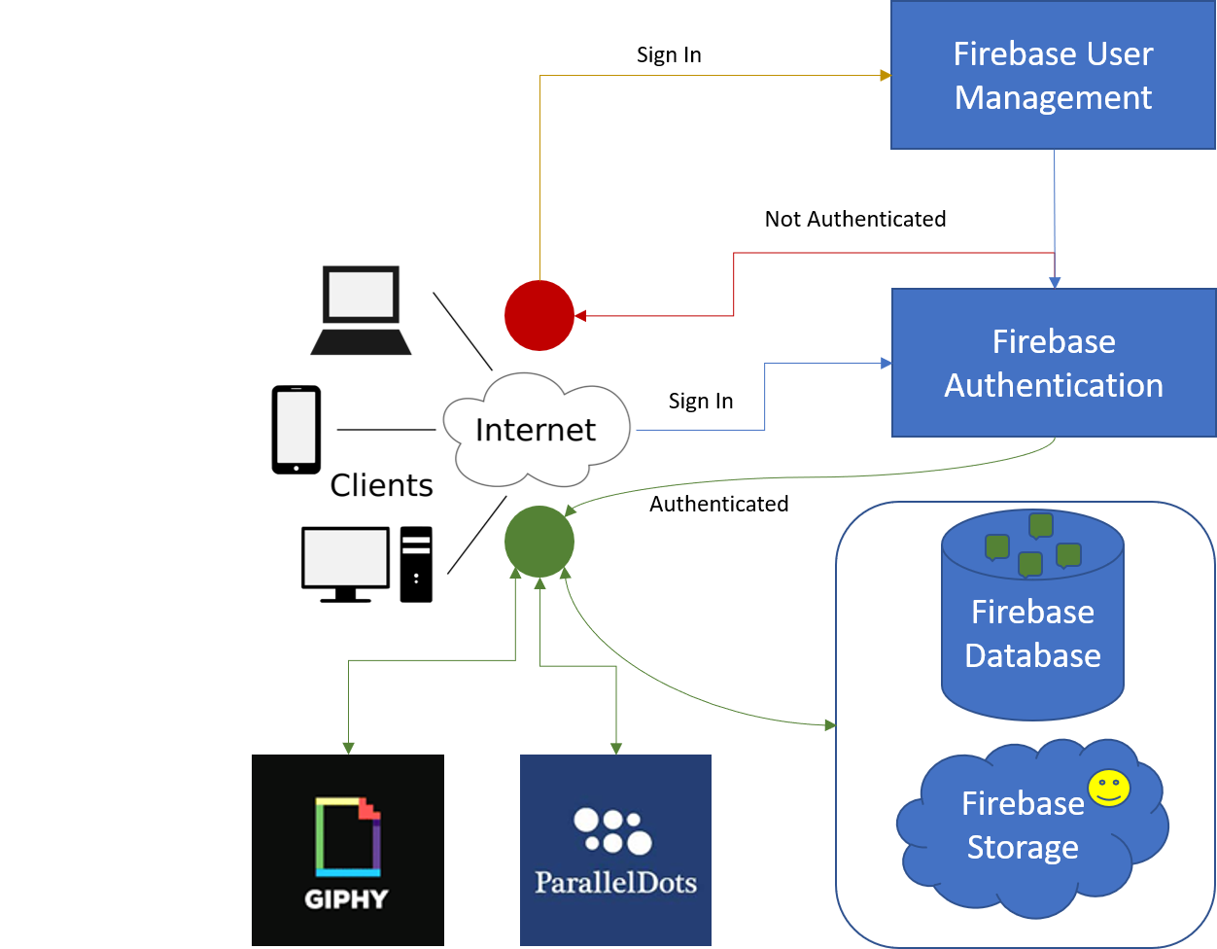
Project Architecture
Notes:
May require more than one slide

Slide 7







Team Efforts
Peer programming for setup and programming tasks
Firebase authentication and database
Trello to track and divide the scenarios into individual tasks
Gitflow to seamlessly work independently and collaborate our work without stepping on each other.
Implemented GitHub code review via pull requests
Applied profanity filter with ParallelDots API
Firebase Storage for smileys

Slide 8
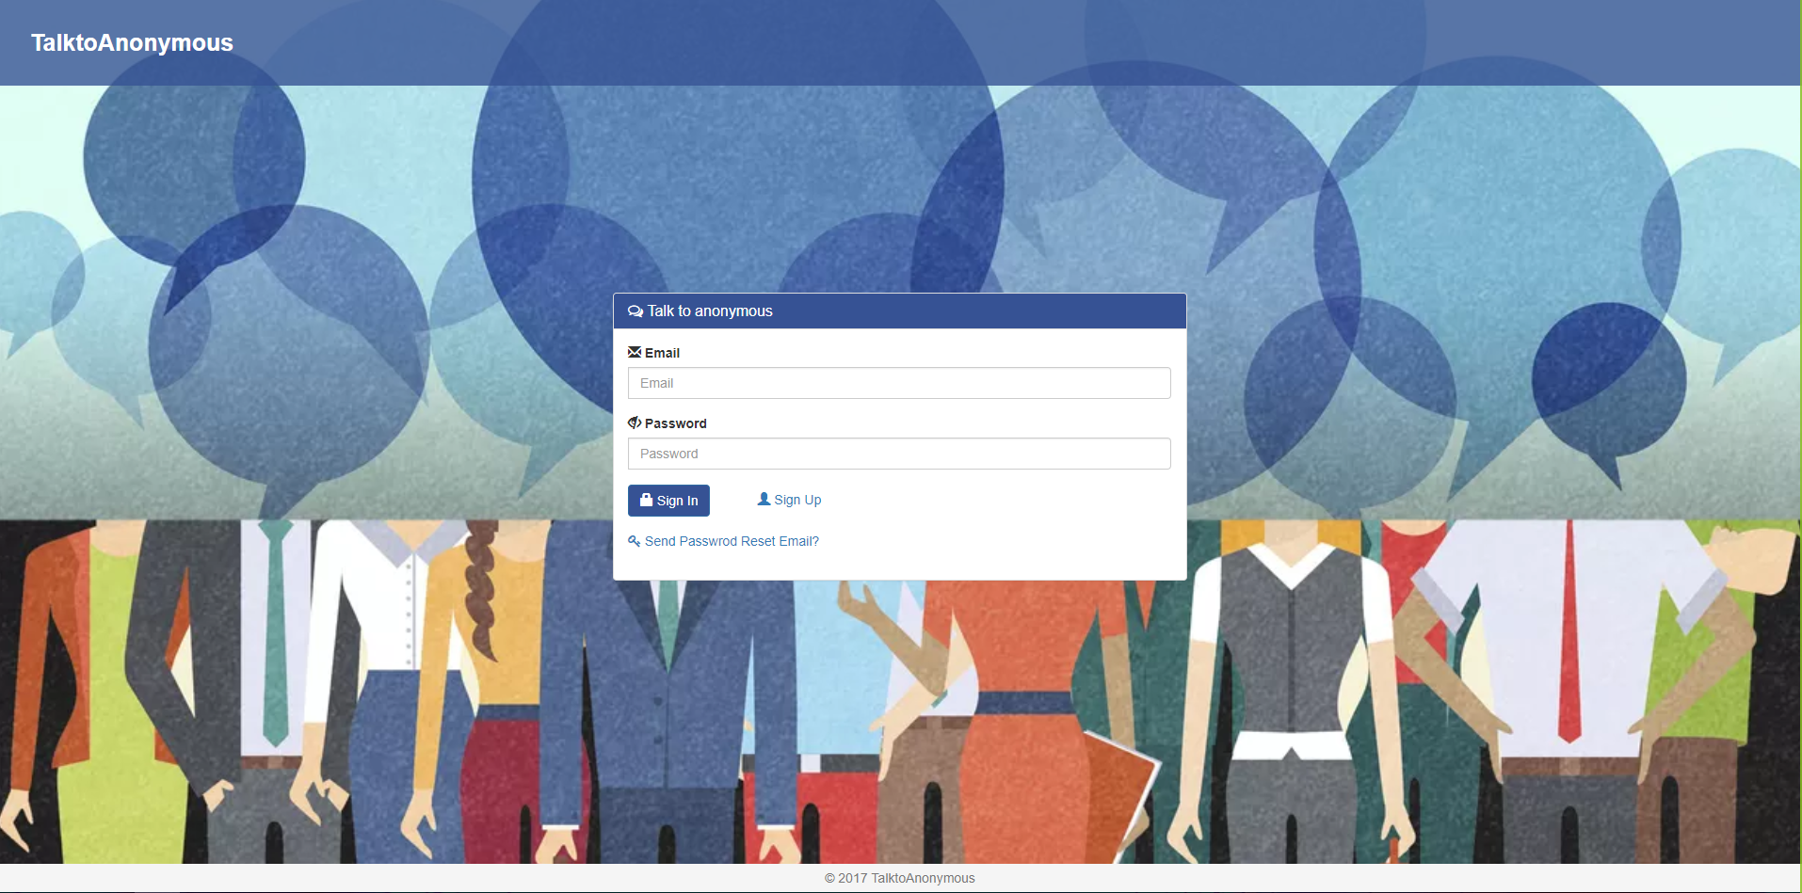
Functionality: Sign-In Form
Notes:
May require more than one slide

Slide 9
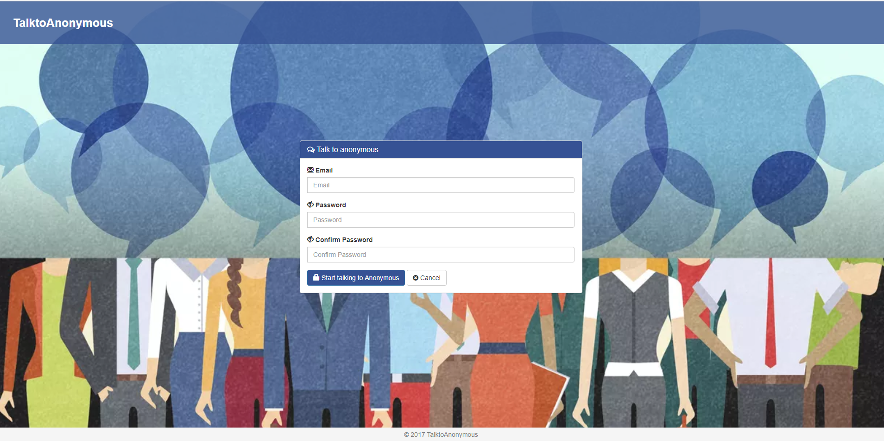
Functionality: Sign-Up Form
Notes:
May require more than one slide

Slide 10
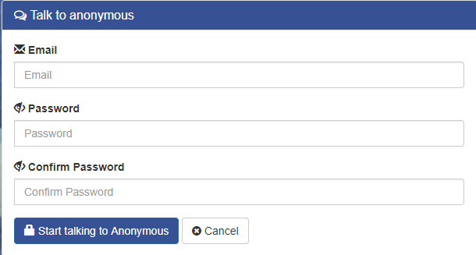
Functionality: Sign-Up Form
Notes:
May require more than one slide

Slide 11
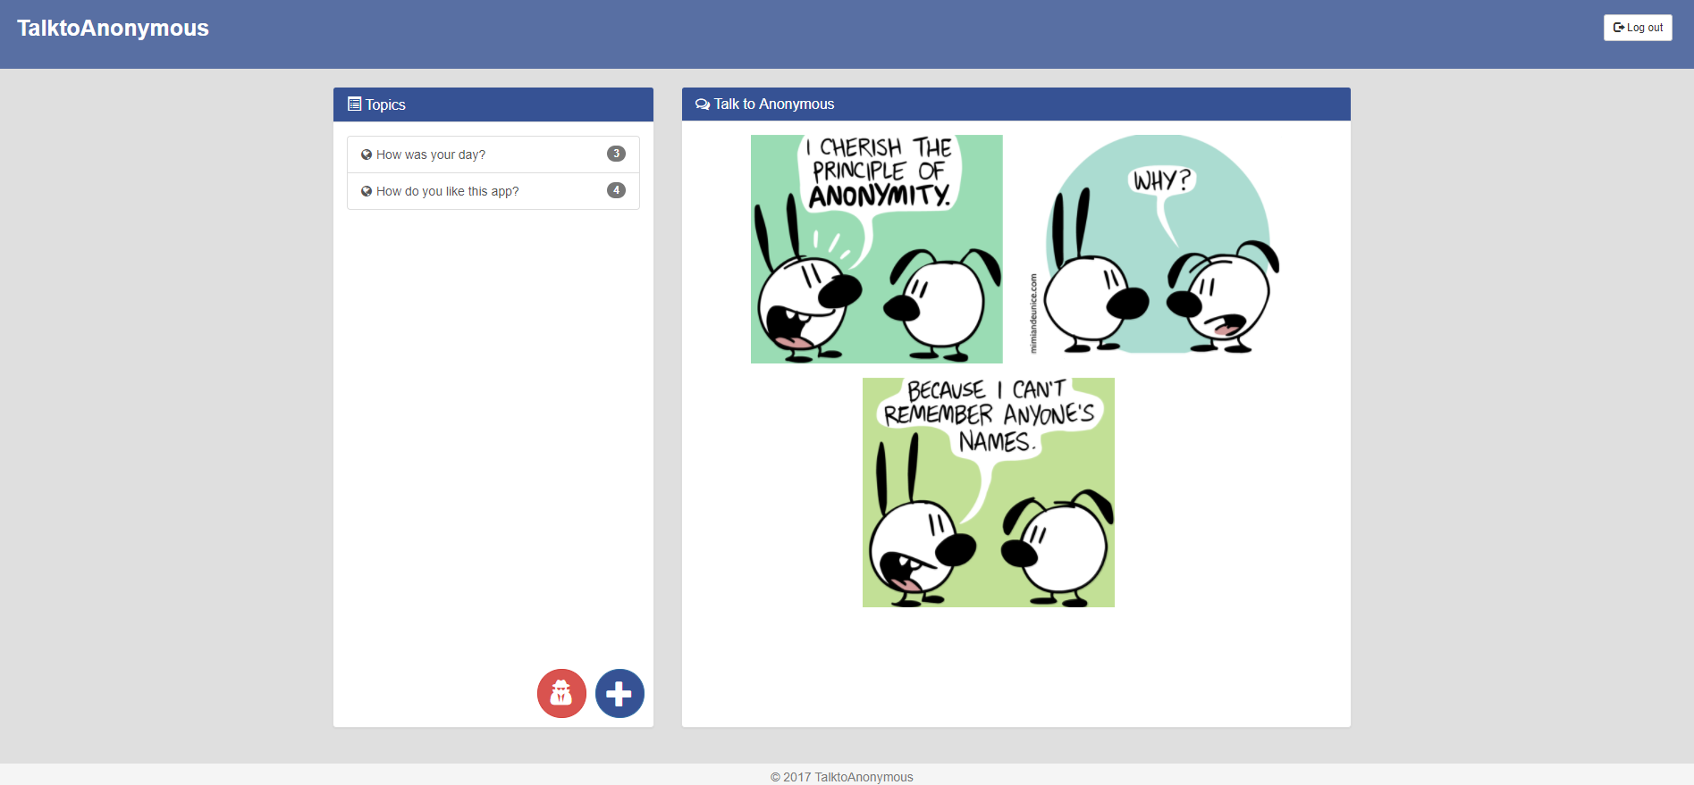
Functionality: Dashboard
Notes:
May require more than one slide

Slide 12
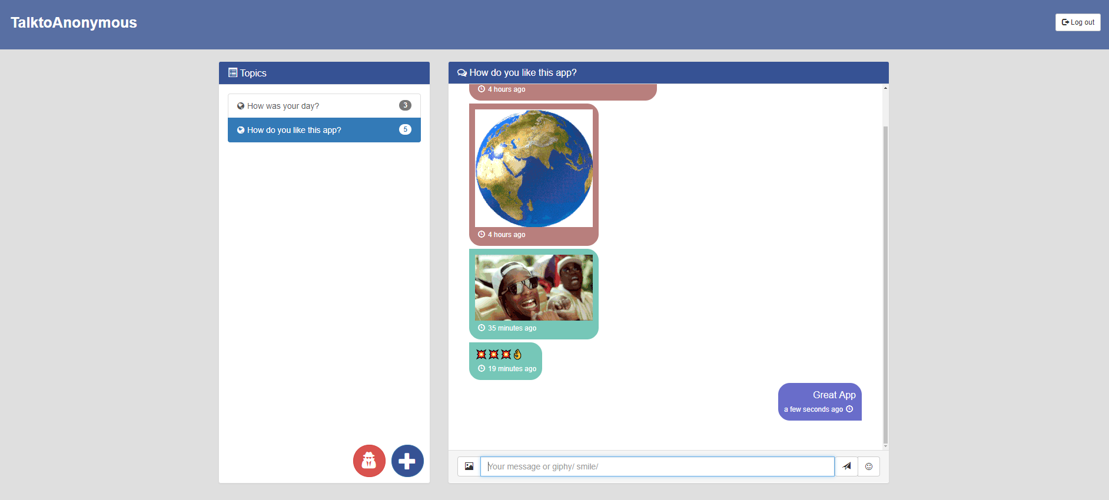
Functionality: Messanger
Notes:
May require more than one slide

Slide 13
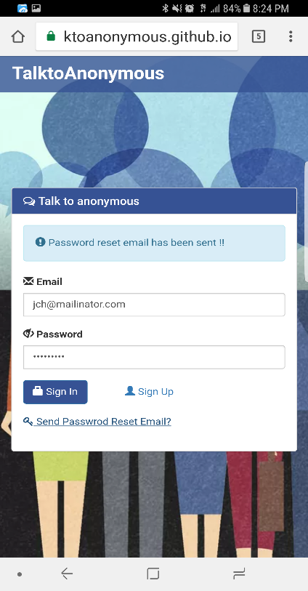
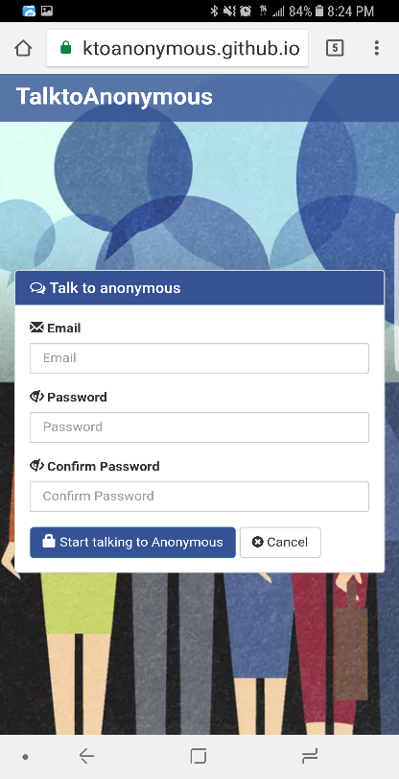
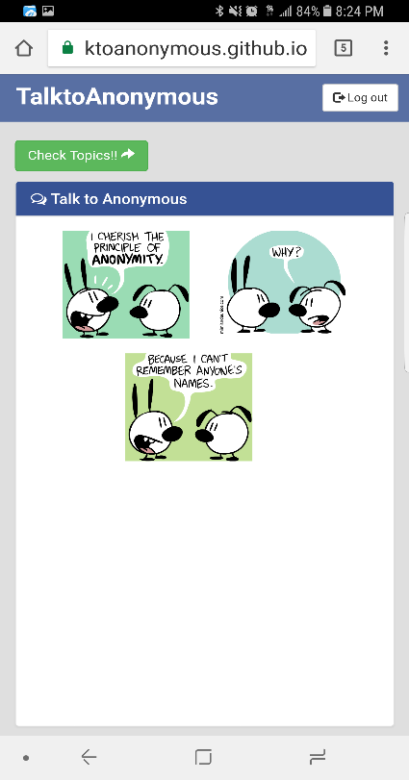
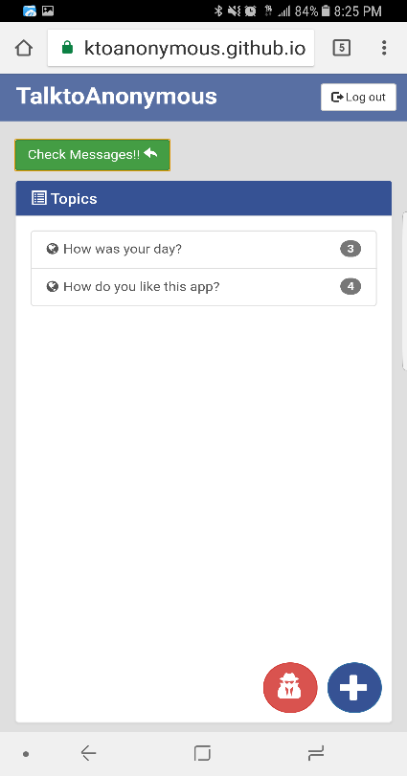
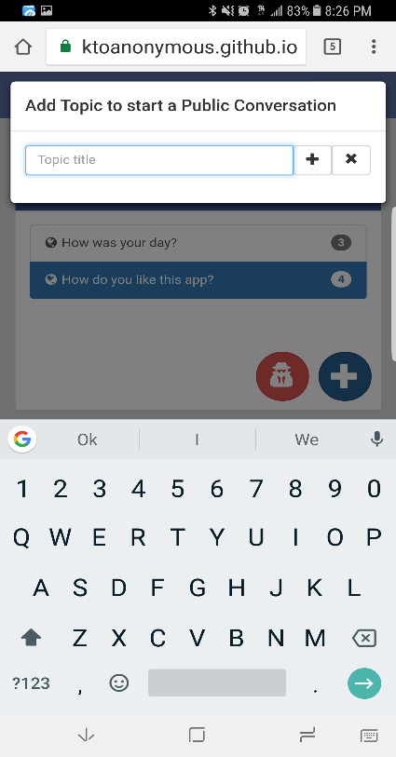
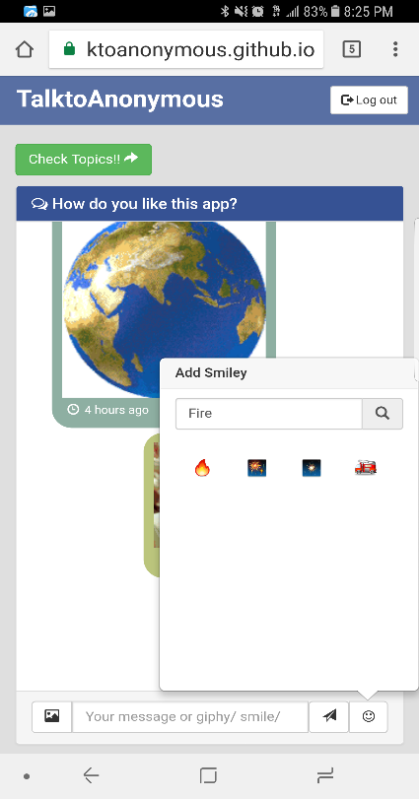
Functionality Mobile

Slide 14
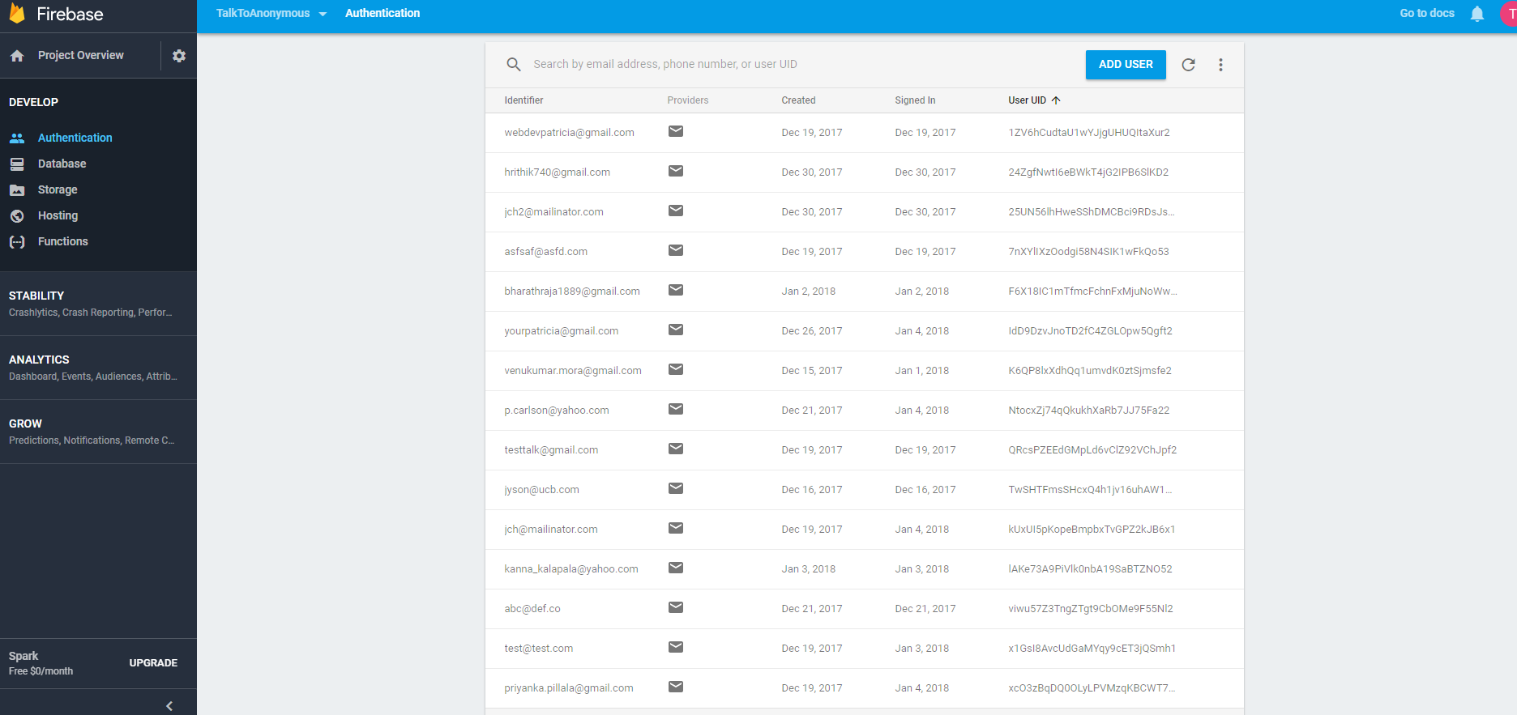
Functionality Firebase Authentication

Slide 15
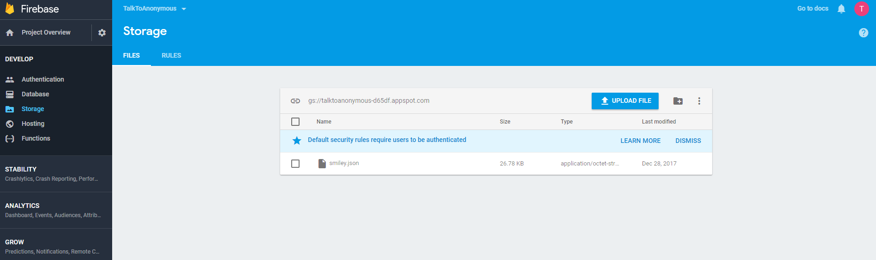
Functionality Firebase Storage

Slide 16
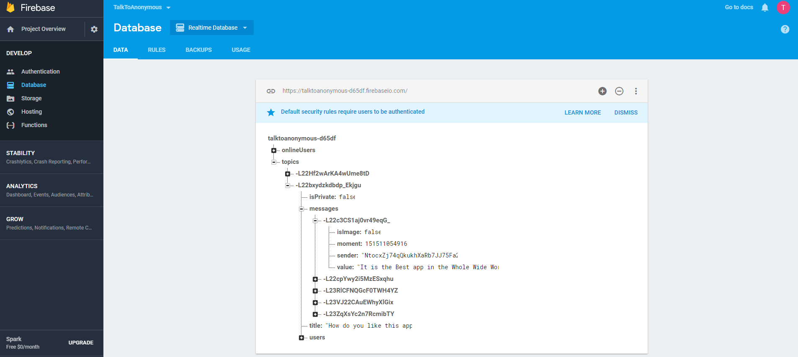
Functionality Firebase Database

Slide 17

Improvements
Deleting and editing messages
Implement anonymous log in
Add file sharing capability
Allow user to create and edit profile
Improve mobile UI
Notes:
May require more than one slide

Slide 18

Results
Help people work through things that are bothering them in an anonymous way
Provides a safe environment to talk about difficult subjects
A great reliever of boredom
May alleviate loneliness
Profanity is blocked

